Slide 1
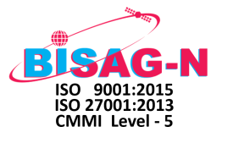

Web Application:
Architecture & Security
Bhaskaracharya National Institute for Space Applications and Geo-informatics (BISAG-N)
Ministry of Electronics and Information Technology
Government of India

Slide 2
SPRING MVC & HIBERNATE FRAMEWORK

Slide 3
SPRING MVC FRAMEWORK
Model, View & Controller
Spring MVC framework have 3 interconnected parts Model, View and Controller.
Model: defines and manages data of application.
View: displays model data to user(web browser).
Controller: performs user requests, contains business logic and returns model to view.
2: set data
1: http request
MODEL
Define Data Structure
CONTROLLER
Service/DAO/
Business Logic/ Security
VIEW
JSP/JQuery/CSS/
JS/HTML 5
3: get data
4: http response
Modular architecture to enhance efficiency in development and upgradation

Slide 4
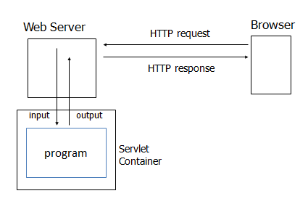
HTTP SERVLET
Processes HTTP request and construct HTTP response
Acts as middle layer between web application program and web browser

Slide 5
HIBERNATE FRAMEWORK
Provides Object Relational Mapping (ORM)
Interaction (middleware) between web application and database schema
Data creation, data manipulation, data access and data security
Session Factory
Model Mapping
JNDI
Connection Provider
Database
Java
Application
Model
Object
JDBC
Session
Transaction
JTA
Core objects of Hibernate Framework
Internal API
Used by
Hibernate

Slide 6
SPRING MVC + HIBERNATE WORKFLOW
Browser/Client
1
HTTP request
Front Controller
Spring
DispatcherServlet
7
2
6
Handler Mapping
View name
HTTP
response
5
Tomcat Server
3
Controller
View Resolver
9
4
8
Service Layer
Model
View
DAO Layer
Hibernate
Database

Slide 7
SPRING MVC + HIBERNATE WORKFLOW
Front Controller /DispatcherServlet receives HTTP request from browser/client.
DispatcherServlet gets an entry of handler mapping from the XML file.
HandlerMapping selects the Controller which is mapped to the incoming request URL and returns the selected Handler and Controller to Dispatcher Servlet.
Controller executes the business logic depending on the transactions mentioned below:
DML(insert/update/delete): sets the data in Model and perform DML operations in database.
DQL(select): get the data from database through Model.
and returns an object of ModelAndView. No DDL operations are permitted in the application to ensure no SQL/HQL injection.
Controller returns the logical name of view.
DispatcherServlet checks the entry of view resolver in the XML file and invokes the specified view component.
DispatcherServlet dispatches the task of resolving the View corresponding to the View name to ViewResolver.
ViewResolver returns the View mapped to View name.
View renders Model data and returns HTTP response.

Slide 8
SPRING MVC + HIBERNATE WORKFLOW
DispatcherServlet receives the request.
DispatcherServlet dispatches the task of selecting an appropriate controller to HandlerMapping. HandlerMapping selects the Controller which is mapped to the incoming request URL and returns the selected Handler and Controller to Dispatcher Servlet.
DispatcherServlet dispatches the task of executing of business logic of Controller to HandlerAdapter.
HandlerAdapter calls the business logic process of Controller.
Controller executes the business logic depending on the transactions mentioned below:
DML(insert/update/delete): sets the data in Model and perform DML operations in database.
DQL(select): get the data from database through Model.
and returns the logical name of view to HandlerAdapter. No DDL operations are permitted in the application to ensure no SQL/HQL injection.
DispatcherServlet dispatches the task of resolving the View corresponding to the View name to ViewResolver. ViewResolver returns the View mapped to View name.
DispatcherServlet dispatches the rendering process to returned View.
View renders Model data and returns the response.

